Slide 1

Journam
Supporting Safe Journeys, Every Step of the Way

Slide 2
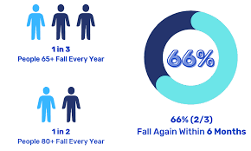
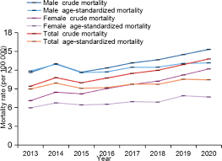


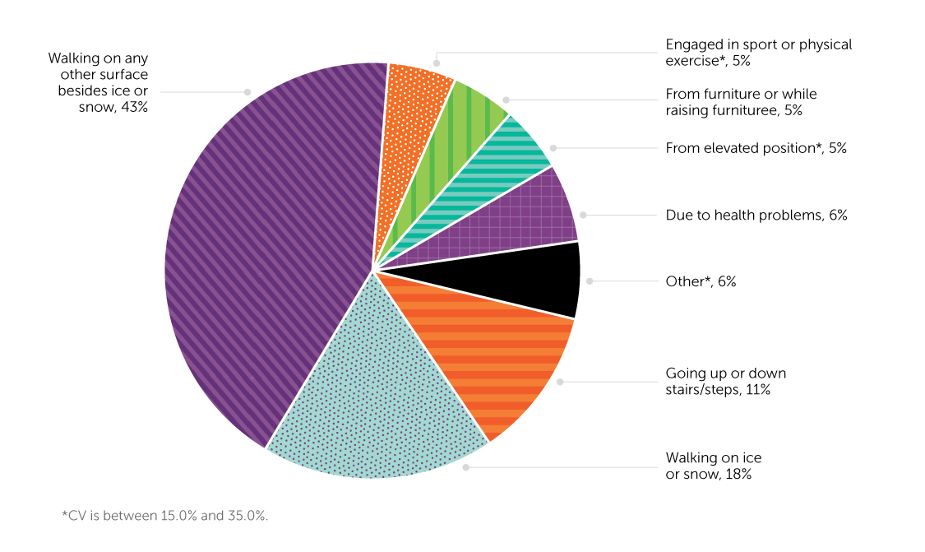

Slide 3


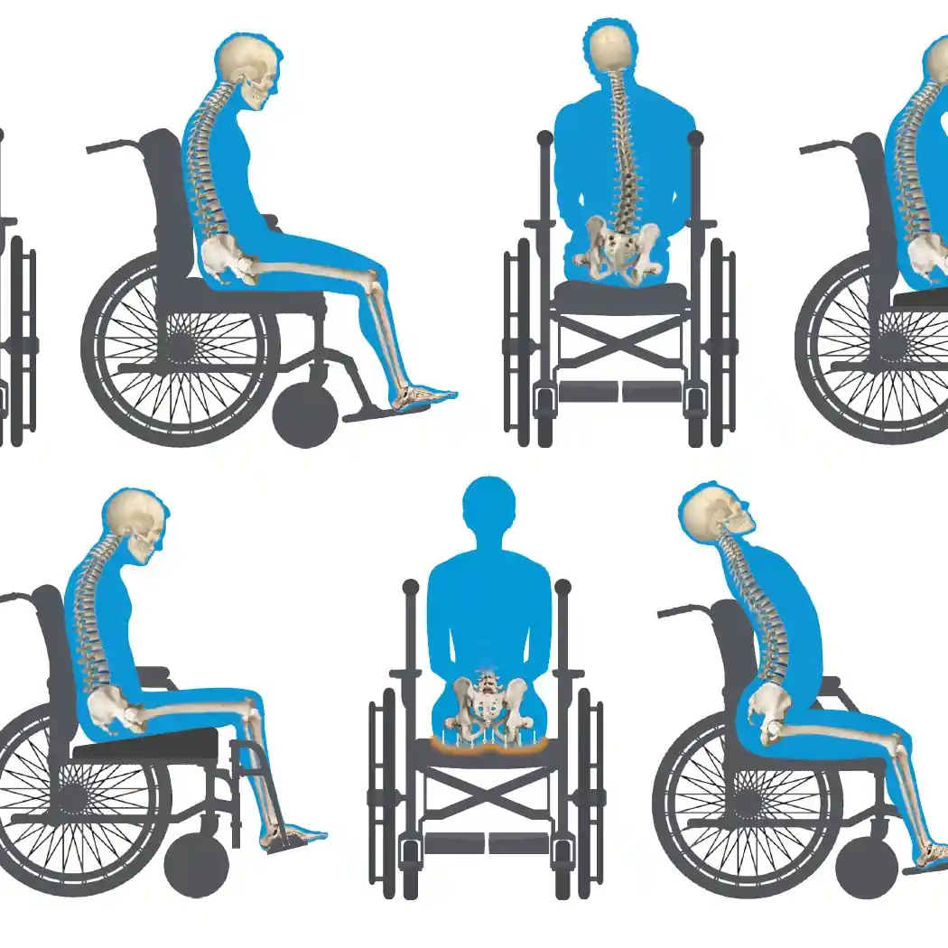

Slide 4

Customer Segments

Slide 5

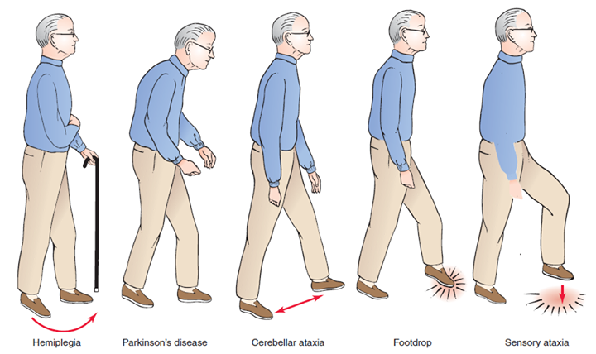
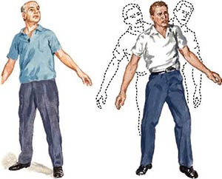
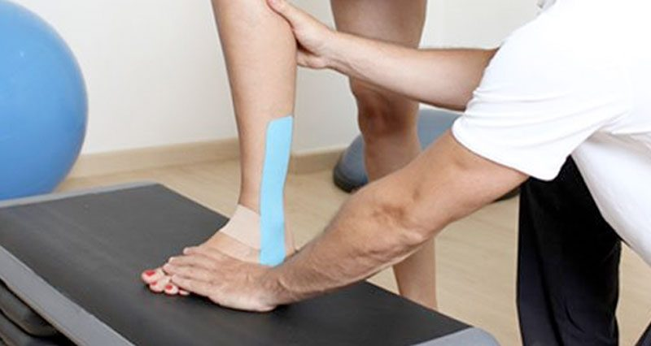

Slide 6




Slide 7

Journam
A wearable that monitors posture and health to improve safety, mobility, and independence.
Supporting Safe Journeys, Every Step of the Way
Revolutionizing Safety for Vulnerable Individuals through real-time posture monitoring and guardian connectivity, ensuring timely interventions to prevent injuries and promote independence.

Slide 8
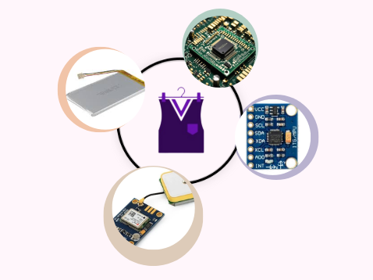
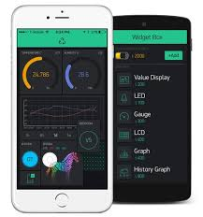
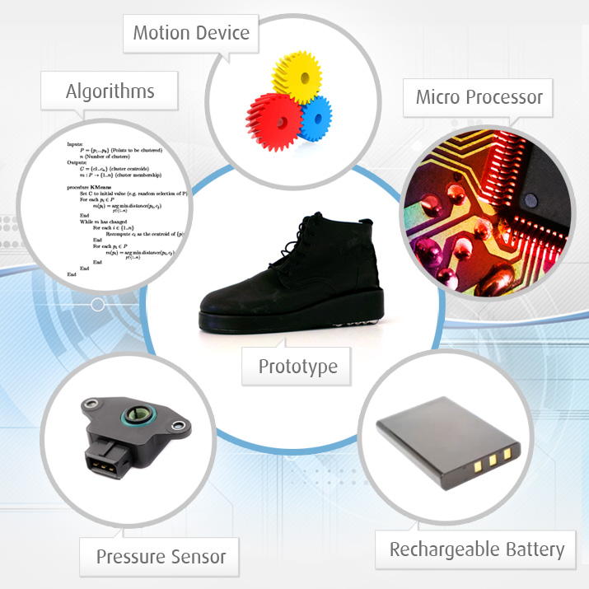
Move Confidently with Journam
Embedded System to implement the detection and correction Algorithms
Integrated Mobile APP

Slide 9

Competition Advantage

Slide 10
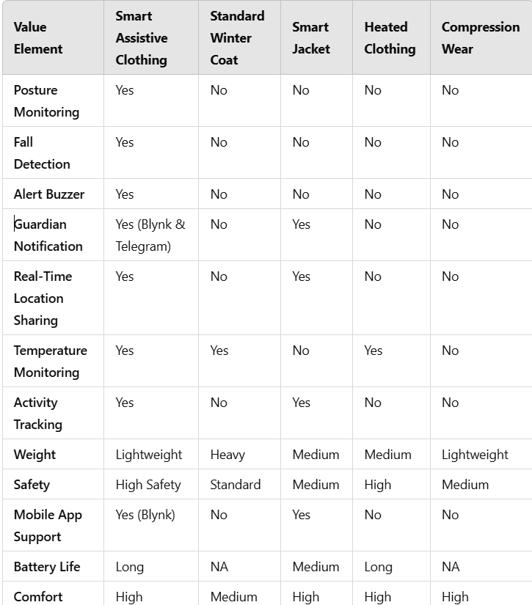

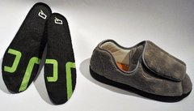
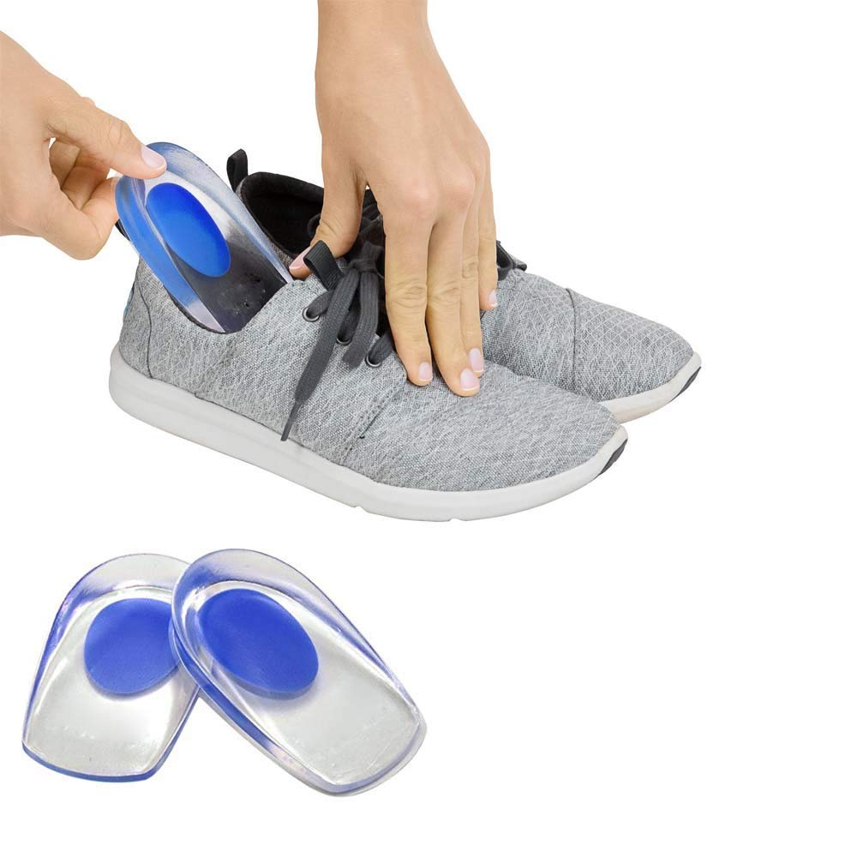
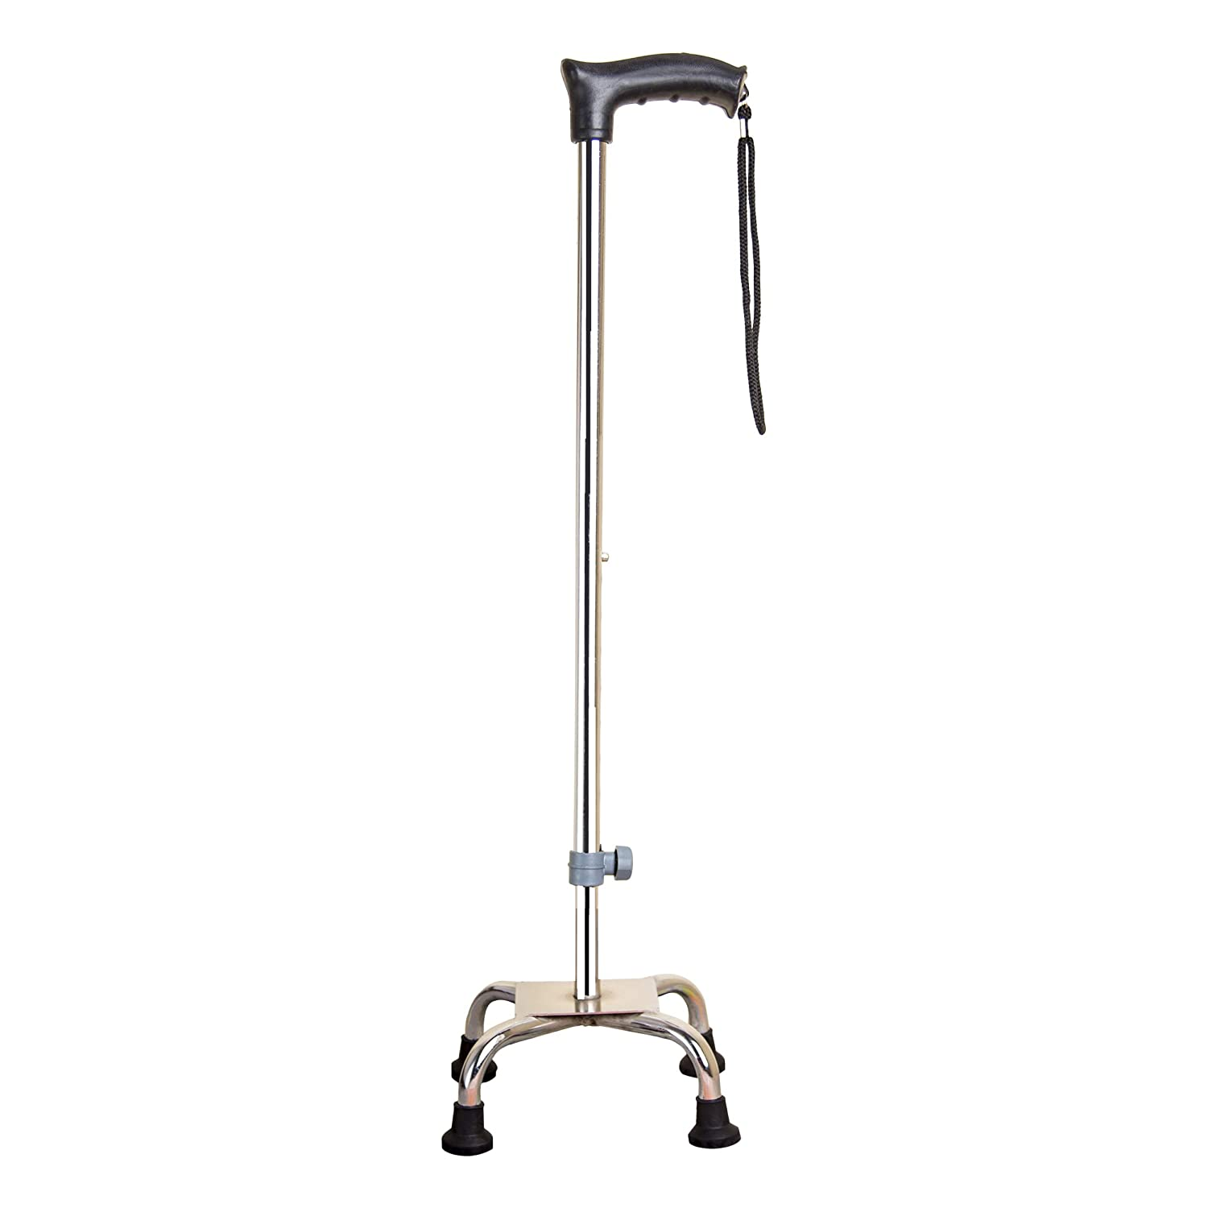
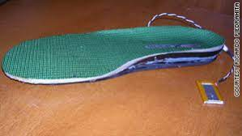


Slide 11

Distribution Channels

Slide 12
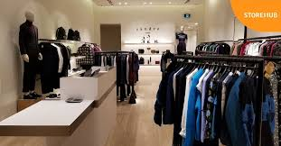
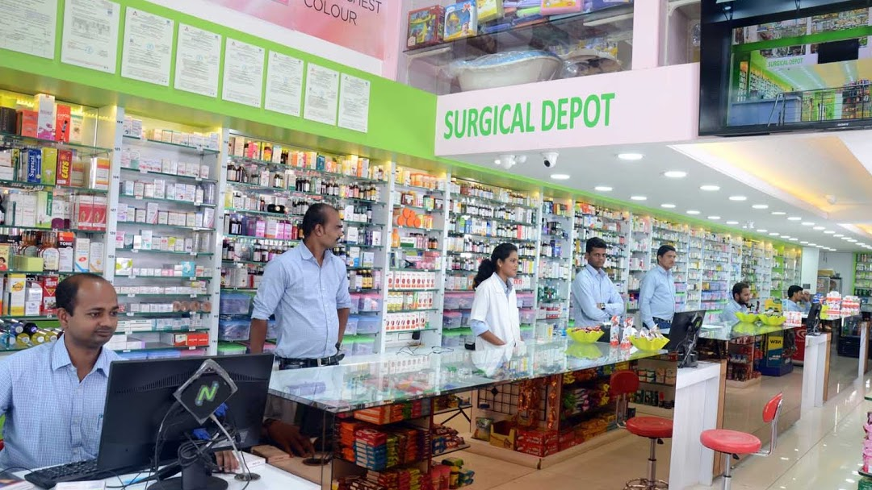
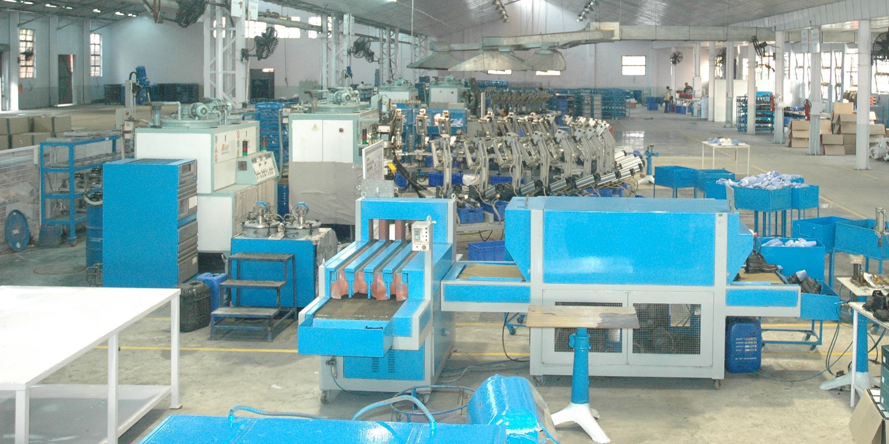


Assistive Clothing Sections in Retail Stores.
Surgical Shops
End Customer
Online Retailers
Manufacturing Unit
Direct to Customer
www.Journam.com

Slide 13

Financials

Slide 14
Cost Structure
COGS Per Unit | 150
Price Per Unit | 400
Break Even In Units(Yearly) | 6000
Burn Rate( Monthly) | -500000
Break Out of OPEX
Marketing | 6 Lakhs
Administrative | 7 lakhs
R&D | 12 Lakhs

Slide 15






Slide 16


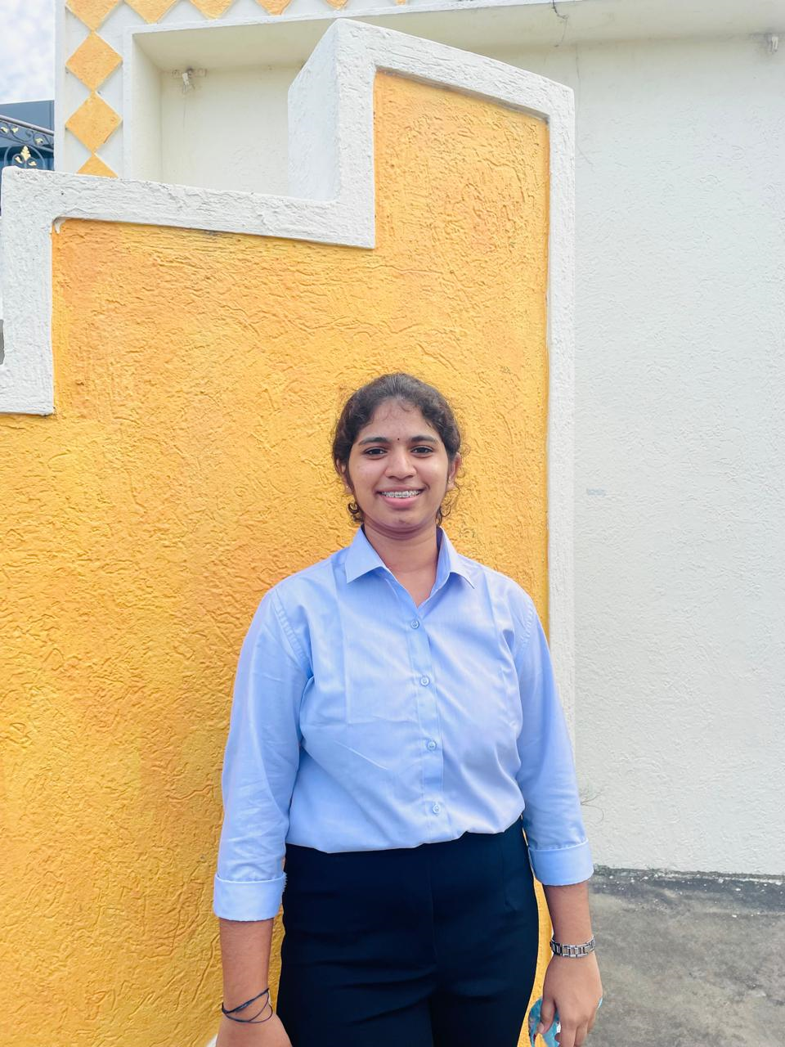


Team Vision Forge
P.Gayathri
K.J.Manjula
Deepthi
N.Likhitha
Project Manager
Product Manager
Hardware Specialist
Programmar

